Slide 1
AI Booster – Week 02 Session 03 – Bivariate stats
Franck JAOTOMBO & Antoine SCHERRER ascherrer@em-lyon.com
Notes:
Let me introduce myself :
Write name on the board : Franck JAOTOMBO
Double training : applied maths and management / organizational behavior
3 Masters degrees : Physics, Philosophy & Maths
1 Ph.D : Management Sciences
I have been in the training business most of my life chiefly as an entrepreneur and /or self-employed
Currently I mainly carry on three taks :
Teach in business schools
Implement statistical studies for colleagues researchers
Work as a free lance data scientist and statitiscian

Slide 2
Outline & Program
One week dedicated to improve your python programming skills and review basic statistical notions
Day 1 => Introduction, data, data cleaning
Day 2 => Univariate statistics
Day 3 (today!) => Bivariate statistics
Day 4 => Hypothesis testing and important distributions
Day 5 => Review linear algebra

Slide 3
Teaching / learning materials
Every day will follow the same schedule
1h30 of lecture (or less)
1h30 of in-class pratice (live coding session)
Afternoon dedicated to practice (Tues., Wed., Thur. With a teaching assistant)
Evaluation => individual quizz at the end of the week + group project (at the end of week 3)

Slide 4
Representing data with tables
Tables and Frequency Distributions

Slide 5
Summarizing two categorical variables : Contingency Table
Contingency Table Showing
Frequency of Invoices Categorized
By Size and The Presence Of Errors
A random sample of 400 invoices is drawn.
Each invoice is categorized as a small, medium or large amount.
Each invoice is also examined to identify if there are any errors.
This data are then organized in the contingency table to the right.
 | No Errors | Errors | Total
Small Amount | 170 | 20 | 190
Medium Amount | 100 | 40 | 140
Large Amount | 65 | 5 | 70
Total | 335 | 65 | 400

Slide 6
Contingency Table Based On Percentage Of Overall Total
 | No Errors | Errors | Total
Small Amount | 170 | 20 | 190
Medium Amount | 100 | 40 | 140
Large Amount | 65 | 5 | 70
Total | 335 | 65 | 400
42.50% = 170 / 400
25.00% = 100 / 400
16.25% = 65 / 400
 | No Errors | Errors | Total
Small Amount | 42.50% | 5.00% | 47.50%
Medium Amount | 25.00% | 10.00% | 35.00%
Large Amount | 16.25% | 1.25% | 17.50%
Total | 83.75% | 16.25% | 100.0%
83.75% of sampled invoices have no errors and 47.50% of sampled invoices are for small amounts.

Slide 7
Contingency Table Based On Percentage of Row Totals
 | No Errors | Errors | Total
Small Amount | 170 | 20 | 190
Medium Amount | 100 | 40 | 140
Large Amount | 65 | 5 | 70
Total | 335 | 65 | 400
89.47% = 170 / 190
71.43% = 100 / 140
92.86% = 65 / 70
 | No Errors | Errors | Total
Small Amount | 89.47% | 10.53% | 100.0%
Medium Amount | 71.43% | 28.57% | 100.0%
Large Amount | 92.86% | 7.14% | 100.0%
Total | 83.75% | 16.25% | 100.0%
Medium invoices have a larger chance (28.57%) of having errors than small (10.53%) or large (7.14%) invoices.
Notes:
The line (row) totals give the frequency (and percentage) of the variable whose the table line are the modalities (or levels)

Slide 8
Contingency Table Based On Percentage Of Column Total
 | No Errors | Errors | Total
Small Amount | 170 | 20 | 190
Medium Amount | 100 | 40 | 140
Large Amount | 65 | 5 | 70
Total | 335 | 65 | 400
50.75% = 170 / 335
30.77% = 20 / 65
 | No Errors | Errors | Total
Small Amount | 50.75% | 30.77% | 47.50%
Medium Amount | 29.85% | 61.54% | 35.00%
Large Amount | 19.40% | 7.69% | 17.50%
Total | 100.0% | 100.0% | 100.0%
61.54% of invoices with errors are of medium size.
Notes:
The columns totals give the frequency (and percentage) of the variable whose the table columns are the modalities (or levels)

Slide 9
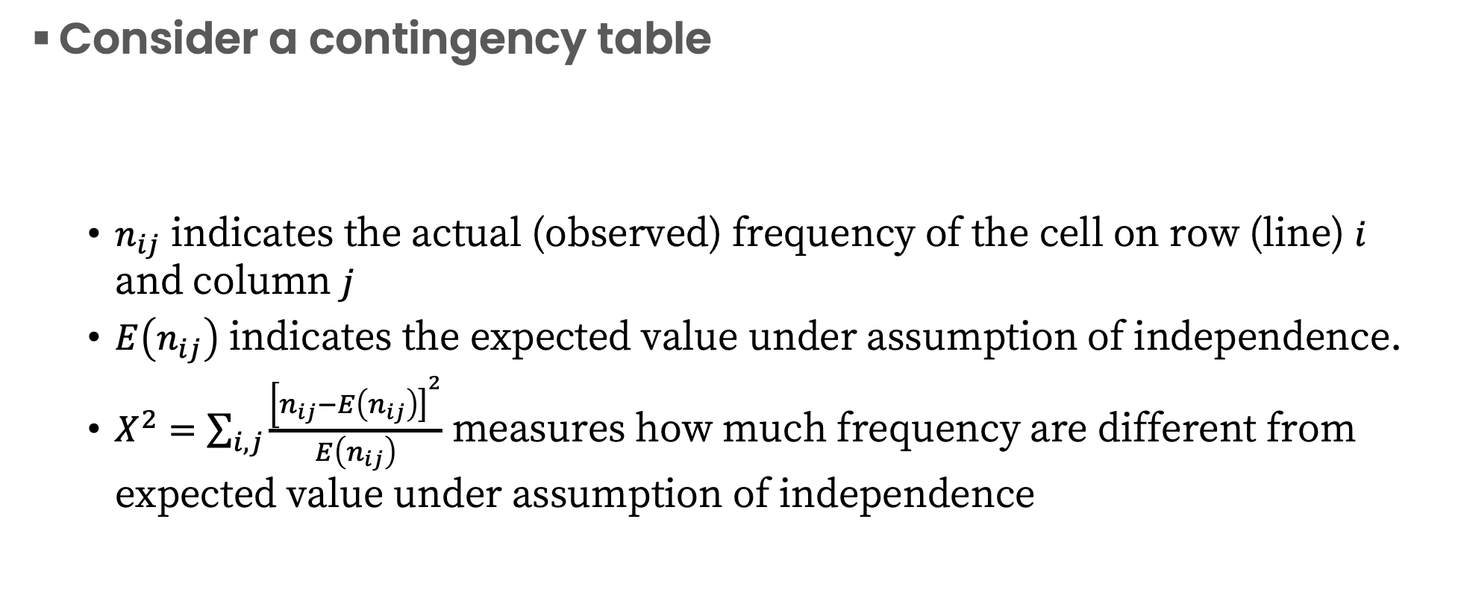
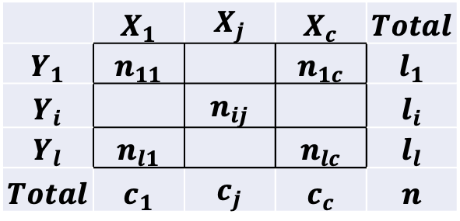
Investigate if variable are independant
 | $$X_{1}$$ | $$X_{j}$$ | $$X_{c}$$ | $$Total$$
$$Y_{1}$$ | $$n_{11}$$ |  | $$n_{1c}$$ | $$l_{1}$$
$$Y_{i}$$ |  | $$n_{ij}$$ |  | $$l_{i}$$
$$Y_{l}$$ | $$n_{l1}$$ |  | $$n_{lc}$$ | $$l_{l}$$
$$Total$$ | $$c_{1}$$ | $$c_{j}$$ | $$c_{c}$$ | $$n$$
Consider a contingency table
$n_{ij}$ indicates the actual (observed) frequency of the cell on row (line) $i$ and column $j$
$E\left(n_{ij}\right)$ indicates the expected value under assumption of independence.
$X^{2}=\sum_{i,j}{\frac{{\left[n_{ij}\right.−\left.E\left(n_{ij}\right)\right]}^{2}}{E\left(n_{ij}\right)}}$ measures how much frequency are different from expected value under assumption of independence

Slide 10
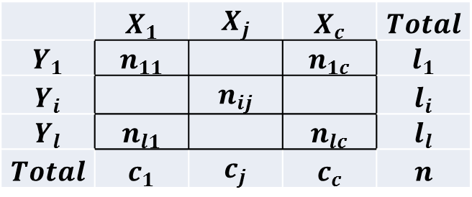

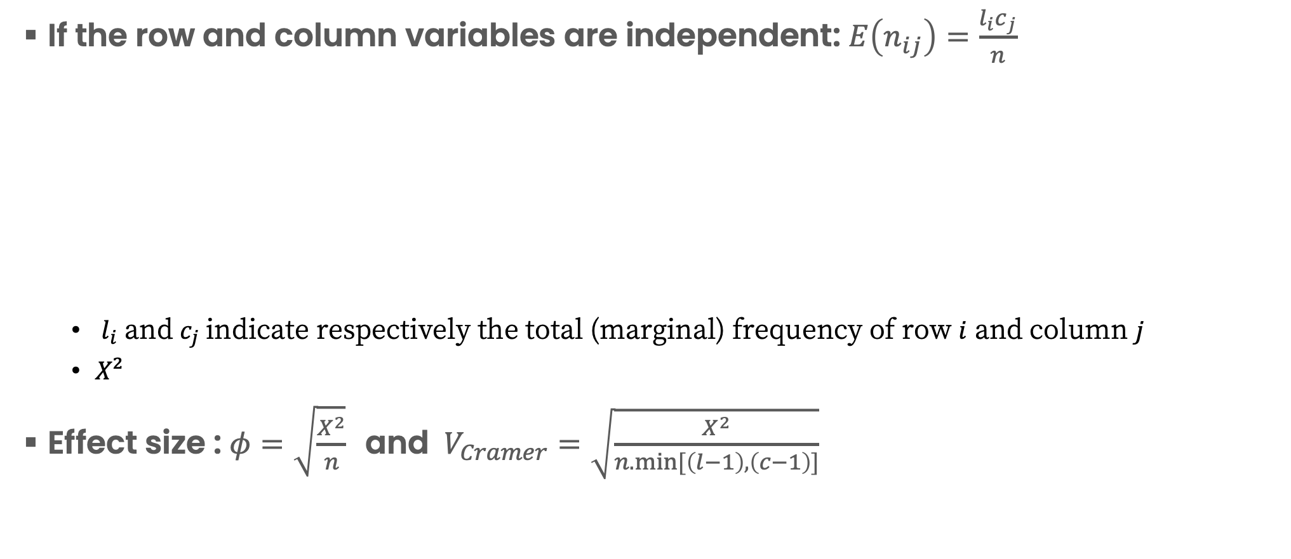
The formula
If the row and column variables are independent: $E\left(n_{ij}\right)=\frac{l_{i}c_{j}}{n}$
${ l}_{i}$ and $c_{j}$indicate respectively the total (marginal) frequency of row $i$ and column $j$
$X²$
Effect size : ${φ=\sqrt{\frac{X^{2}}{n}} \text{and} V}_{Cramer}=\sqrt{\frac{X^{2}}{n.min⁡[\left(l−1\right),\left(c−1\right)]}}$
$$X^{2}=\sum_{i,j}{\frac{{\left[n_{ij}\right.−\left.\frac{l_{i}c_{j}}{n}\right]}^{2}}{\frac{l_{i}c_{j}}{n}}}$$
 | $$X_{1}$$ | $$X_{j}$$ | $$X_{c}$$ | $$Total$$
$$Y_{1}$$ | $$n_{11}$$ |  | $$n_{1c}$$ | $$l_{1}$$
$$Y_{i}$$ |  | $$n_{ij}$$ |  | $$l_{i}$$
$$Y_{l}$$ | $$n_{l1}$$ |  | $$n_{lc}$$ | $$l_{l}$$
$$Total$$ | $$c_{1}$$ | $$c_{j}$$ | $$c_{c}$$ | $$n$$

Slide 11
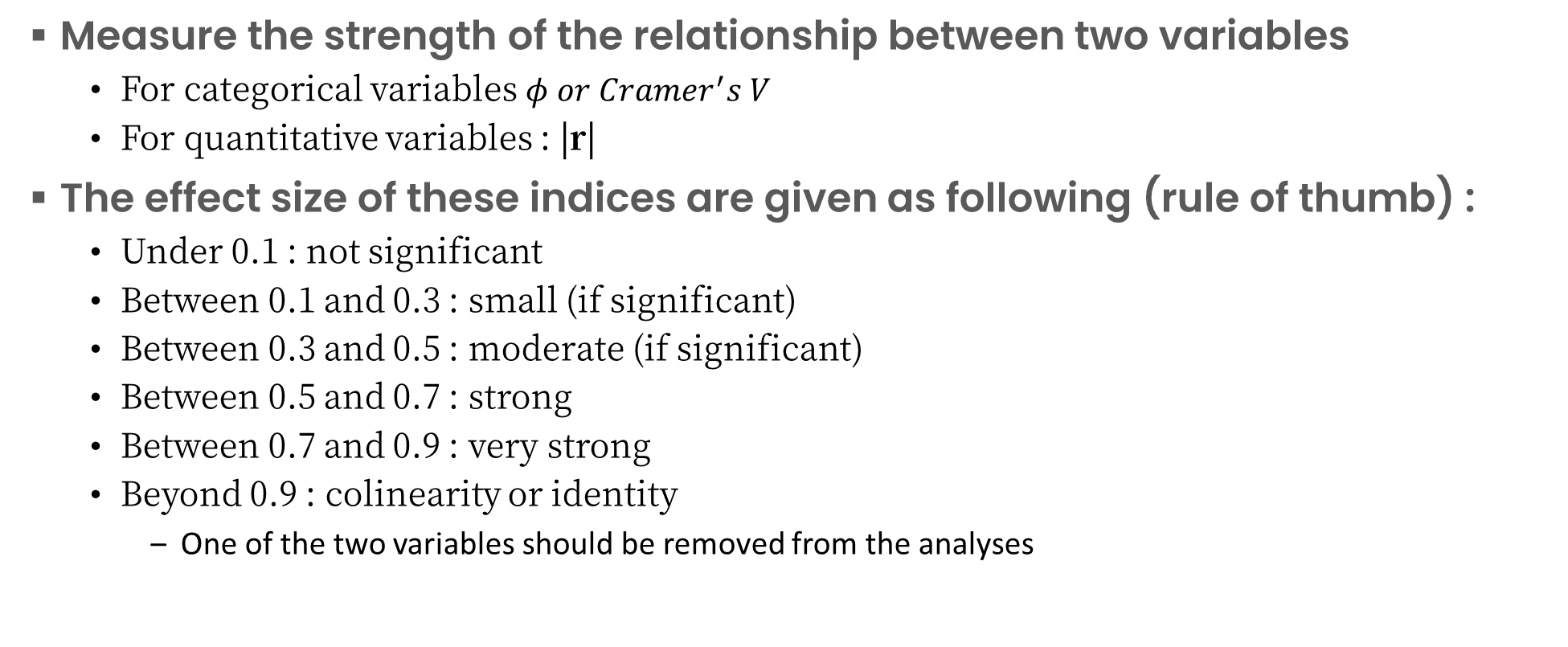
Effect size
Measure the strength of the relationship between two variables
For categorical variables $φ or Cramer^{′}s V$
For quantitative variables : |r|
The effect size of these indices are given as following (rule of thumb) :
Under 0.1 : not significant
Between 0.1 and 0.3 : small (if significant)
Between 0.3 and 0.5 : moderate (if significant)
Between 0.5 and 0.7 : strong
Between 0.7 and 0.9 : very strong
Beyond 0.9 : colinearity or identity
One of the two variables should be removed from the analyses

Slide 12
Effect size
Measure the strength of the relationship between two variables
For categorical variables $φ or Cramer^{′}s V$
For quantitative variables : |r|
The effect size of these indices are given as following (rule of thumb) :
Under 0.1 : not significant
Between 0.1 and 0.3 : small (if significant)
Between 0.3 and 0.5 : moderate (if significant)
Between 0.5 and 0.7 : strong
Between 0.7 and 0.9 : very strong
Beyond 0.9 : colinearity or identity
One of the two variables should be removed from the analyses

Slide 13
Covariance and correlation
How do we describe how much 2 variables are correlated?

Slide 14
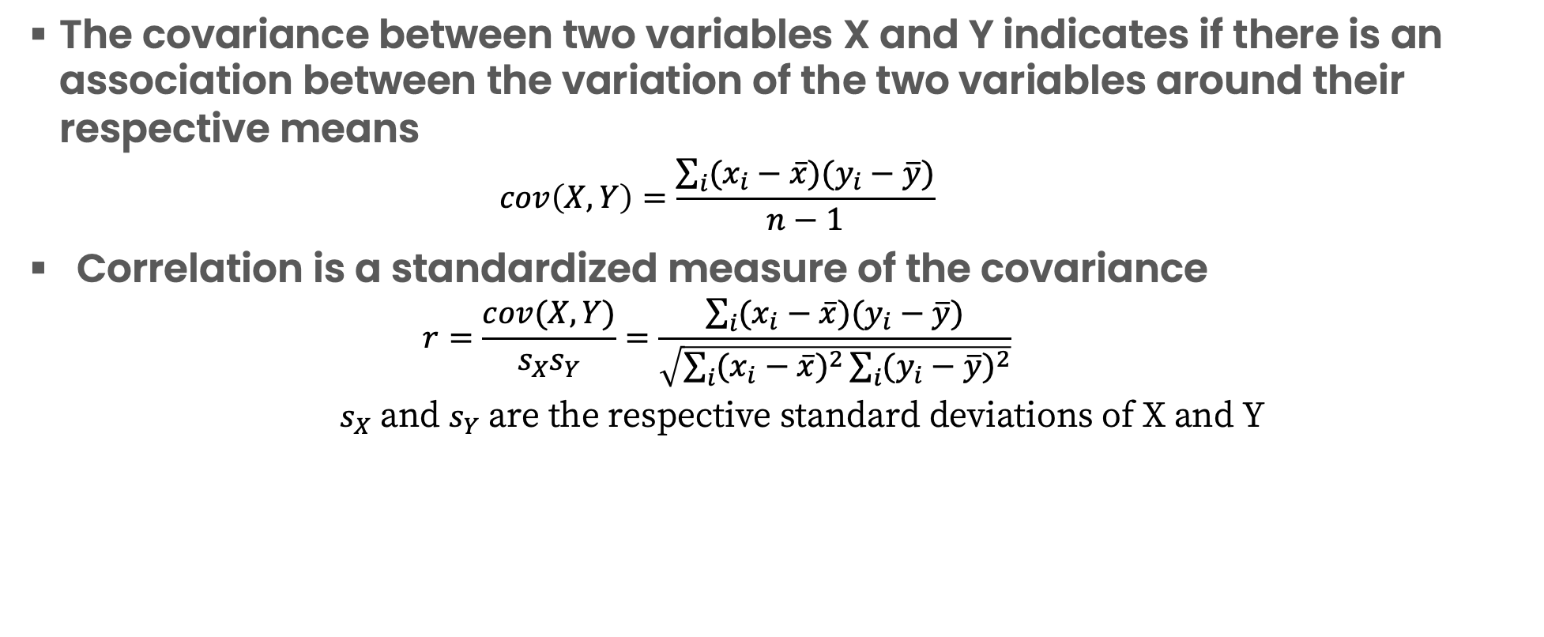
Covariance and correlation
The covariance between two variables X and Y indicates if there is an association between the variation of the two variables around their respective means
$$cov\left(X,Y\right)=\frac{\sum_{i}{(x_{i}−\overline{x})(y_{i}−\overline{y})}}{n−1}$$
Correlation is a standardized measure of the covariance
$$r=\frac{cov(X,Y)}{s_{X}s_{Y}}=\frac{\sum_{i}{(x_{i}−\overline{x})(y_{i}−\overline{y})}}{\sqrt{\sum_{i}{{(x_{i}−\overline{x})}^{2}}\sum_{i}{{(y_{i}−\overline{y})}^{2}}}}$$
$s_{X}$ and $s_{Y}$ are the respective standard deviations of X and Y

Slide 15
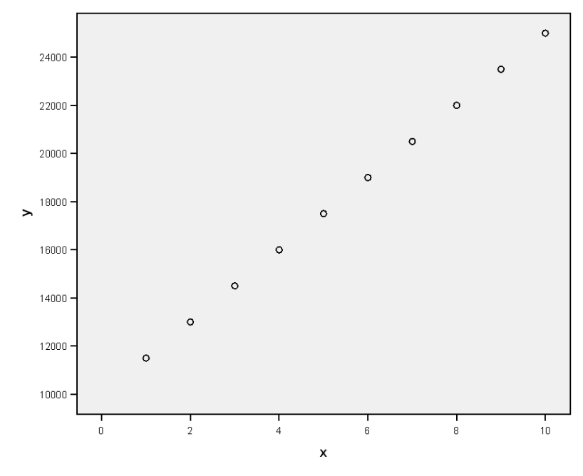
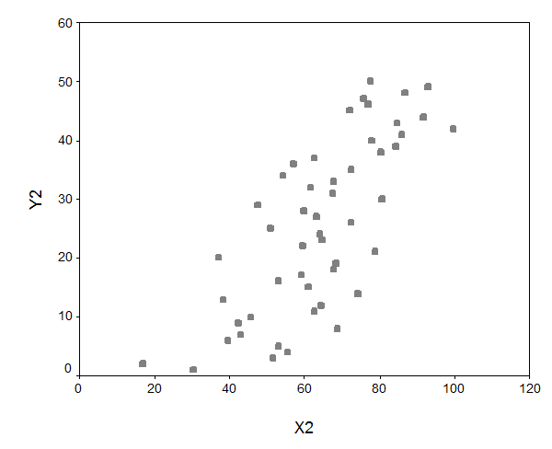
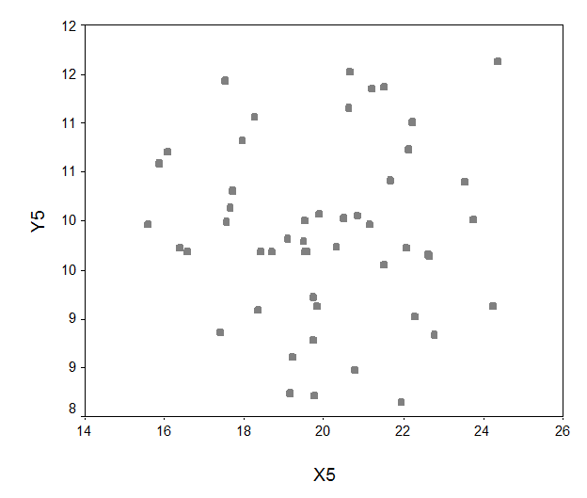
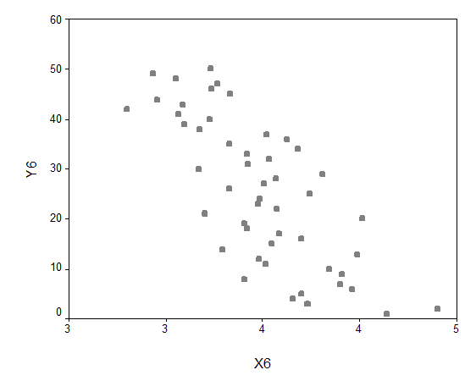




Examples (scatter plots)
$$r=0.7$$
$$r=1$$
$$r=−0.7$$
$$r=0$$

Slide 16
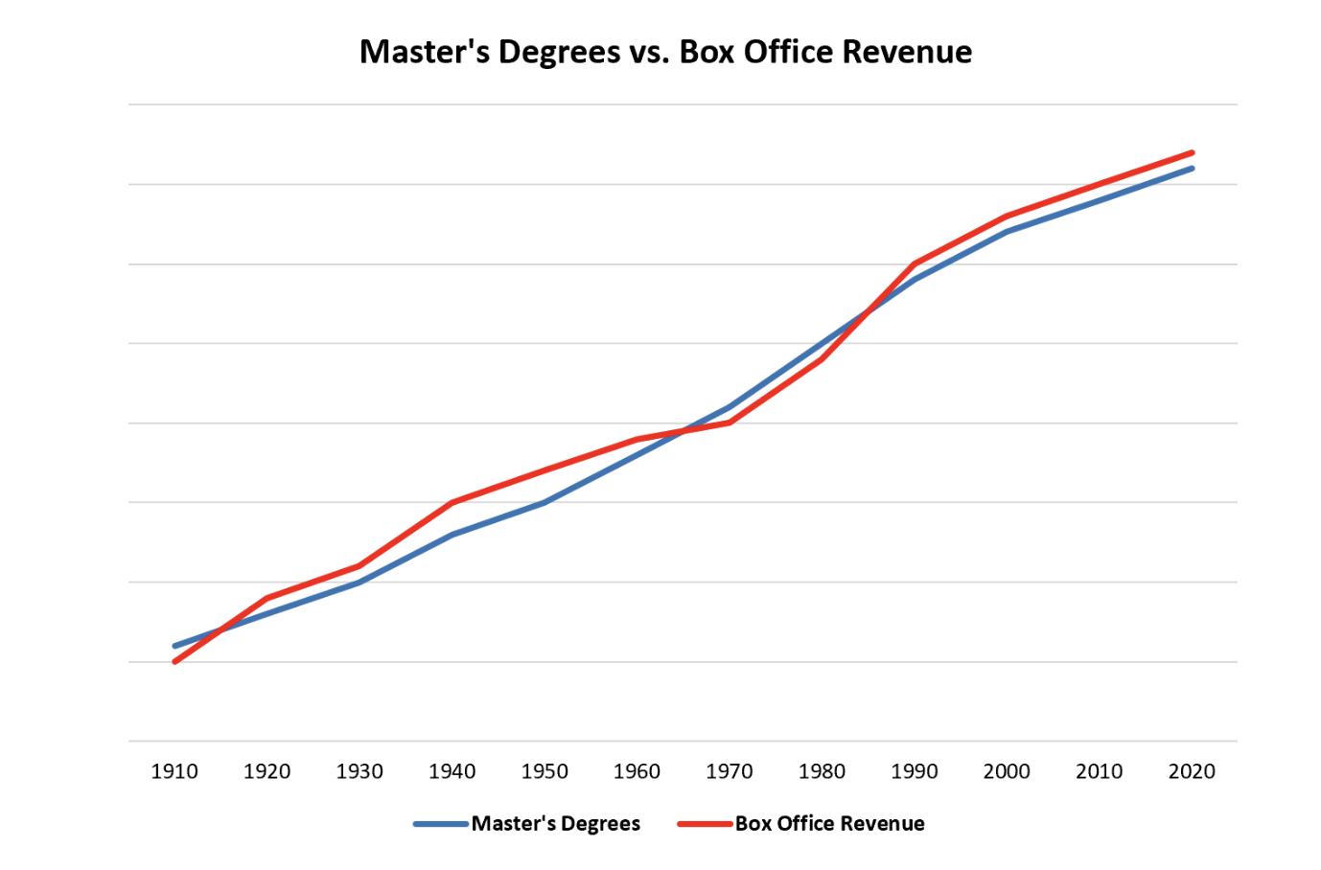
Correlation vs causation
Correlation does not imply causation !!!
Major pitfall in interpretations of statistics…

Slide 17
Any questions ? + Let’s start coding !

